Slide 1
Acquisition
Tracking
Navigation

Slide 2

Signal
s(t)
Carrier Gen
Correlators
NCO
$$\frac{1}{T}\int{\left(∙\right)}dt$$
Code Gen

Slide 3
PA
PAC
Clock
Phase register
Look-up table
Output Sine/Cosine
INCREMENT VALUE
FSW*

Slide 4
30
Phase function
Overflow
25
20
15
Phase accumulator
10
5
0
0
2
4
6
8
10
12
14
16
18
Cycly counts
Clock period

Slide 5
1.5
High resolution cosine wave
Low resolution cosine wave
1
0.5
Amplitude
0
-0.5
-1
0
1
2
3
4
5
6
7
8
9
10
Phase accumulator

Slide 6
Clock
G1
1
2
3
4
5
6
7
8
9
10
Init: All ones
C/A code
1
2
3
4
5
6
7
8
9
10
G2
Phase select

Slide 7
Original signal
Original signal
1
1
Amplitude
Amplitude
0.5
0.5
0
0
0
10
20
30
40
50
0
10
20
30
40
50
Time
Time
Original signal
Delayed signal(Shift 9 bit(s))
1
1
Amplitude
Amplitude
0.5
0.5
0
0
0
10
20
30
40
50
0
10
20
30
40
50
Time
Time
Auto-correlation
Cross-correlation
10
10
Amplitude
Amplitude
5
5
0
0
-50
0
50
-50
0
50
Shift
Shift

Slide 8
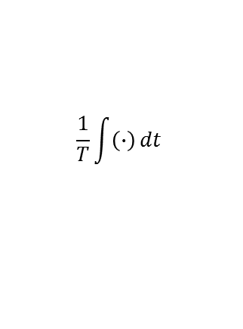
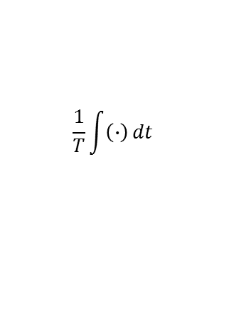



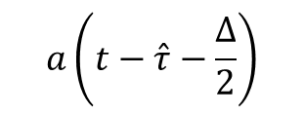




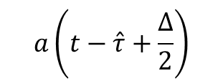
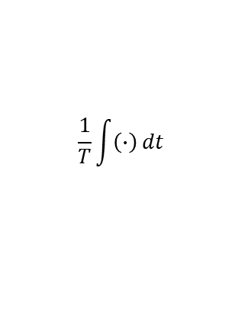
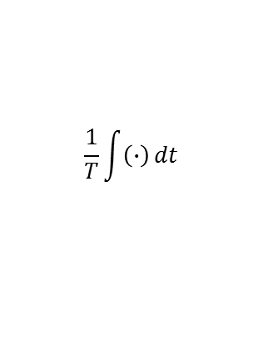


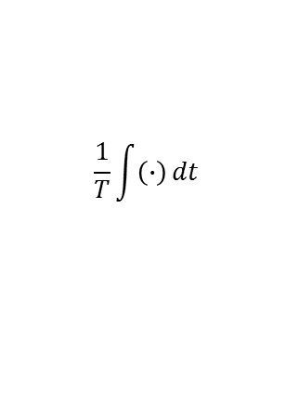
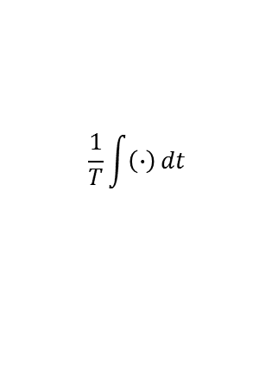
$$\frac{1}{T}\int{\left(∙\right)}dt$$
$$w_{IL}$$
$$\frac{1}{T}\int{\left(∙\right)}dt$$
$$w_{IE}$$
$$\frac{1}{T}\int{\left(∙\right)}dt$$
$$w_{IP}$$
$$cos\left(\left(ω_{IF}+{\hat{ω}}_{D}\right)t+\hat{φ}\right)$$
$$a\left(t−\hat{τ}+\frac{∆}{2}\right)$$
$$a\left(t−\hat{τ}−\frac{∆}{2}\right)$$
$$sin\left(\left(ω_{IF}+{\hat{ω}}_{D}\right)t+\hat{φ}\right)$$
$$a\left(t−\hat{τ}\right)$$
$$\frac{1}{T}\int{\left(∙\right)}dt$$
$$w_{QP}$$
$$\frac{1}{T}\int{\left(∙\right)}dt$$
$$w_{QE}$$
$$\frac{1}{T}\int{\left(∙\right)}dt$$
$$w_{QL}$$

Slide 9

Y
Signal
EM waves
$$γ$$
v
Receiver
0
X

Slide 11
Signal block n
Signal block n+1
…
0
1
…
…
1022
…
Local code block n
Local code block n+1

Slide 12
Input
signal
Early
code
Prompt
code
Late
code
L
P
E
1
1
1
P
E
L
P
1/2
1/2
1/2
0
E
L
0
0
-1
0
-1/2
0
1/2
1
-1/2
0
1/2

Slide 13
code_subcarr_delay_reg_u
L
P
E
98
73
49
25
0

Slide 15
2000
I Phase
e
1000
d
u
0
t
i
l
p
m
-1000
A
-2000
0
5
10
15
20
25
30
35
40
45
50
Time (ms)
4000
Q Phase
e
2000
d
u
t
i
l
0
p
m
A
-2000
-4000
0
5
10
15
20
25
30
35
40
45
50
Time (ms)
15
10
6
Sum of square
X
8
e
Y
14970400
d
10
u
t
i
l
p
m
A
5
Average noise: 1700000
0
0
5
10
15
20
25
30
35
40
45
50
Time (ms)

Slide 16
TEXT

